Slide 1
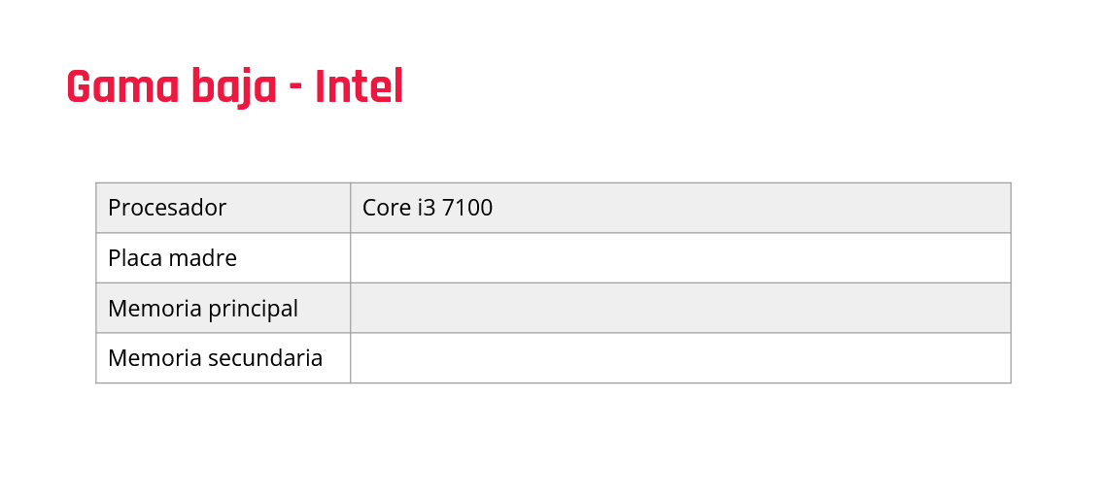
Msi Placa Madre H110m-
DDR4 4GB 2666MHz Vengeance LPX
Disco Duro PC 250G Blue

Slide 2
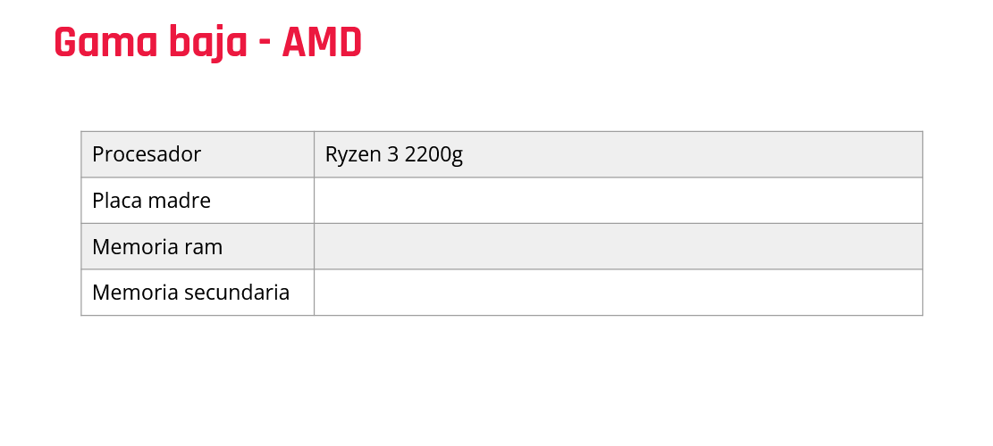
M/B AMD PRime A320M-K
4GB DDR4 DIMM- Value
250GB SSD MX500 Sata3

Slide 3
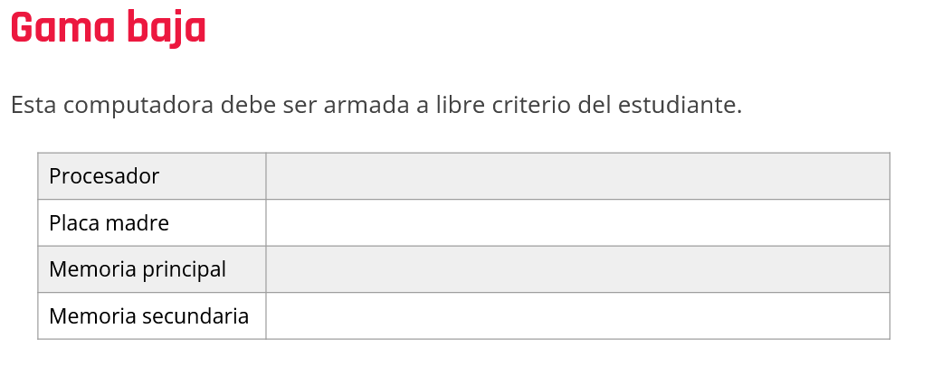
AMD Ryzen 3 PRO 4350G hasta 4.0GHz
M/B AMD B450M-A Prime I
8GB DDR4 DIMM 3200MHz Value RAM
SSD 240GB Sata3 2.5" A400

Slide 4
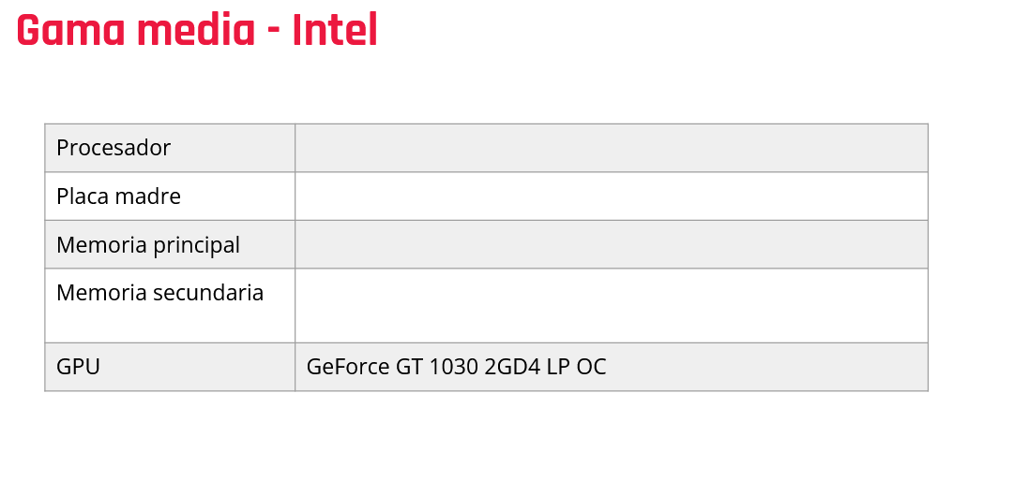
Intel® Core™ i5-9400F 2.90GHZ hasta 4.10GHz
M/B Intel B360M-A
4GB DDR4 2666 MHz DIMM
Disco Duro 1TB Sata3 7200 rpm P300

Slide 5
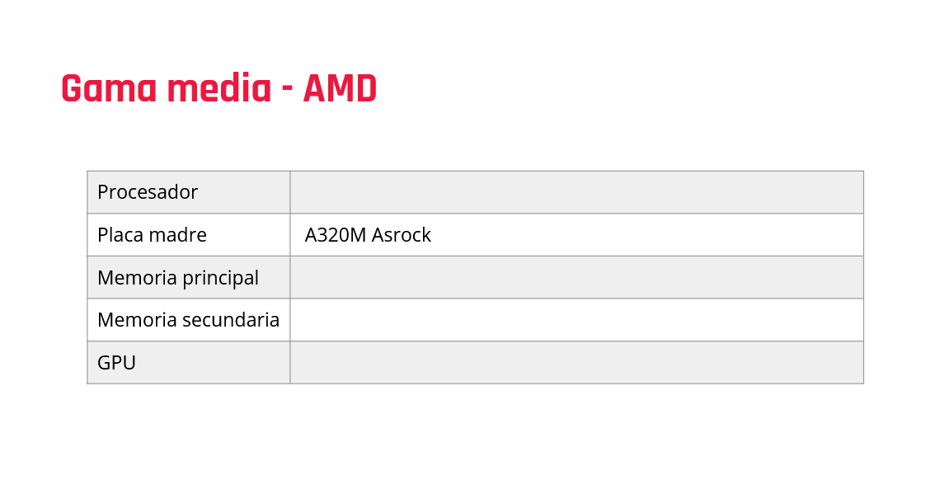
AMD Ryzen 5 4650G hasta 4.2GHz
8GB 2666MHz DDR4 DIM
Disco Duro 1TB Sata3 7200rpm P300 + 128GB SSD Sata 2.5" 520MB/s
Radeon™ Graphics

Slide 6
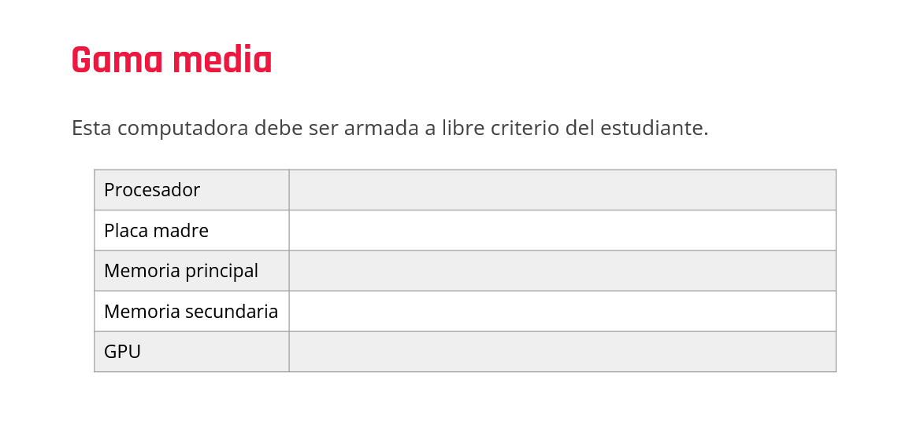
AMD Ryzen 5 5600G Box hasta 4.4GHz
M/B AMD B450M PRO-M2 Max
8GB 2666MHz DDR4 DIMM
Disco Duro 1TB Sata3 7200 rpm P300
Asus - NVIDIA GeForce GTX1650 4GB Dual

Slide 7
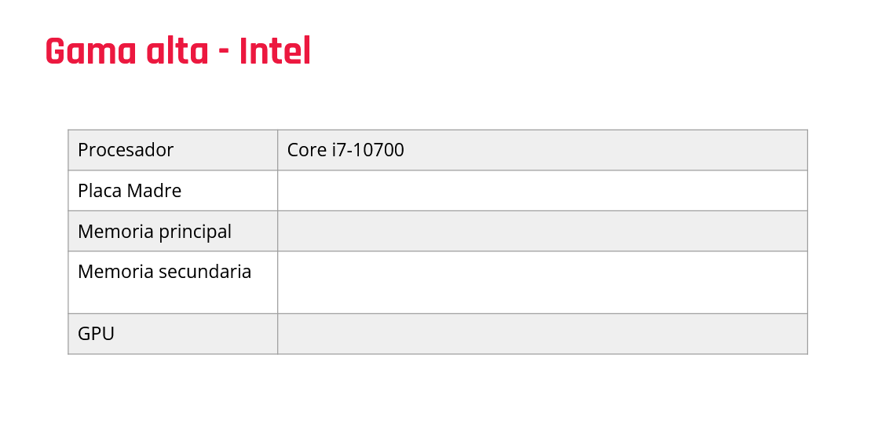
M/B Intel H510M-E Prime
6GB DDR4 2666MHz Value RAM DIMM
480GB SSD Sata3 2.5 BX500
Gigabyte - NVIDIA GeForce RTX 2060 Windforce 12GB

Slide 8
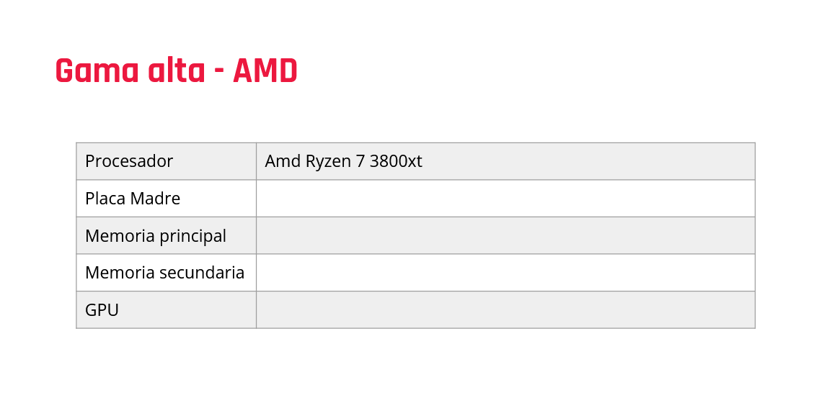
M/B AMD B550 TUF Gaming Plus WiFi II
8GB DDR4 2400MHz Value RAM
250GB SSD MX500 Sata3 2.5"
Gigabyte - NVIDIA GeForce RTX 2060 Windforce 12GB

Slide 9
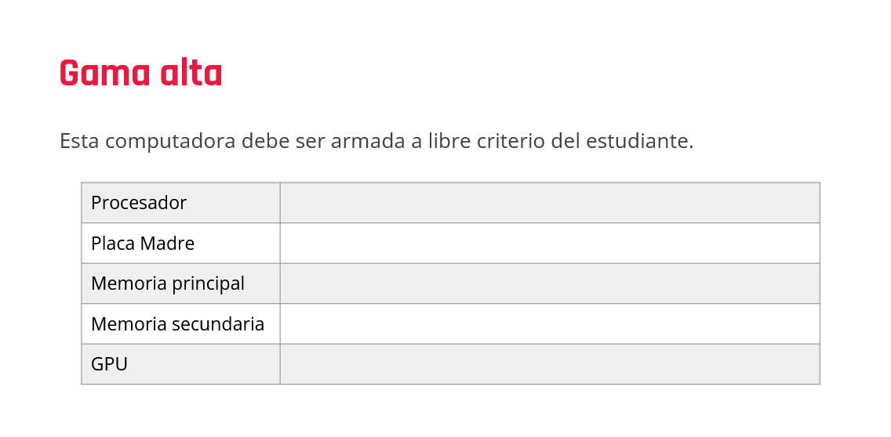
AMD Ryzen 5 5600X Box hasta 4.6GHz
M/B AMD B550 TUF Gaming Plus
16GB DDR4 2666MHz Value Ram DIMM
500GB SSD Sata3 2.5" Blue
Asus - TUF- RTX3080 10GB v2 Gaming

